Slide 1
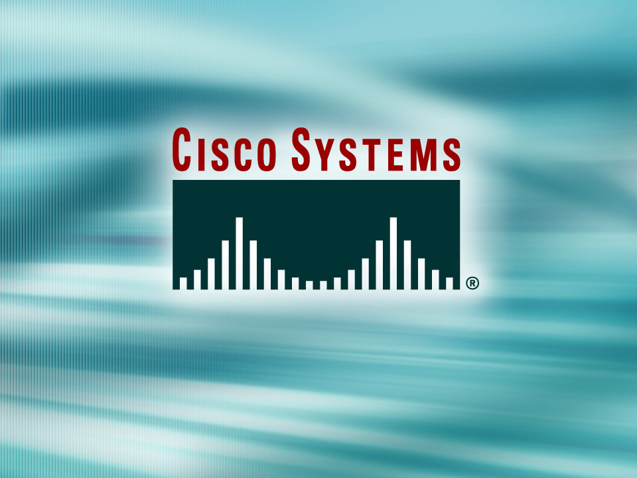
© 2002, Cisco Systems, Inc. All rights reserved.

Slide 2

Enabling OSPF
© 2002, Cisco Systems, Inc. All rights reserved.
Notes:
Purpose: This chapter introduces the Cisco IOS™ CLI on the Catalyst® 1900 switch and router.
Timing: This chapter should take about 2 hours to present.
Note: The Catalyst 1900 switch only has a subset of the router Cisco IOS commands available.
Contents:
Introduction to Cisco IOS. Explain to the student what is IOS?
Cisco Device startup procedures in general.
IOS configuration source.
General introduction to the IOS CLI.
Cat 1900 switch startup procedures.
Intro to Cat 1900 CLI. This part covers the basic configuration on the switch, like setting the IP address and hostname. More details about the various Cat 1900 switch configuration commands are explained in Chapter 6 and 7.
Router startup procedures. More details on the router startup process is discussed in chapter 5.
Router IOS CLI.

Slide 3
Objectives
Upon completing this lesson, you will be able to:
  Describe the features and operation of OSPF
  Use Cisco IOS commands to configure dynamic routing for a single area OSPF network, given a functioning router
  Use show and debug commands to identify anomalies in dynamic routing operation using OSPF, given an operational router
Notes:
Slide 1 of 2
Purpose: This slide states the chapter objectives.
Emphasize: Read or state each objective so that each student has a clear understanding of the chapter objectives.
Note: Catalyst switches have different CLIs. The Catalyst 2900xl and the Catalyst 1900 has a Cisco IOS CLI. The Cisco IOS CLI commands available on the 2900xl is different from the 1900. The Catalyst 5000 family has no Cisco IOS CLI, and use the set commands instead. This class only covers the configuration on the Catalyst 1900 switch.

Slide 4
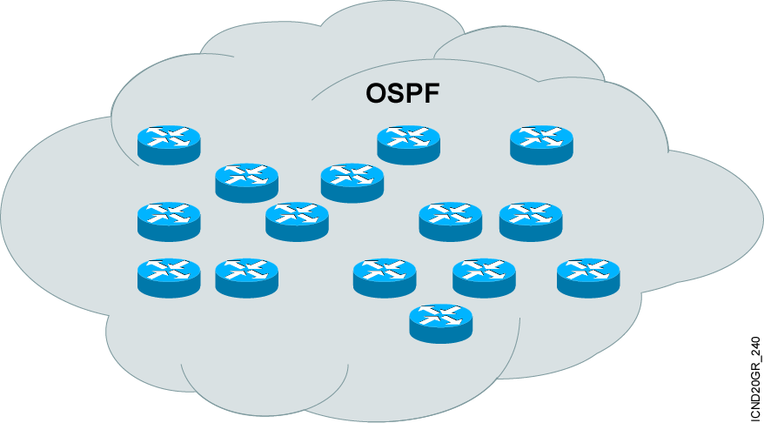
Introducing OSPF
  Open standard
  Shortest path first (SPF) algorithm
  Link-state routing protocol (vs. distance vector)
Notes:
Purpose: The figure introduces the IGRP routing protocol. IGRP is a sophisticated distance vector routing protocol.
Emphasize: The Interior Gateway Routing Protocol (IGRP) is a dynamic distance-vector routing protocol designed by Cisco in the mid-1980s for routing in an autonomous system that contains large, arbitrarily complex networks with diverse bandwidth and delay characteristics. Historically, IGRP became one of the success factors for the early Cisco IOS software capabilities because of its superiority to RIP version 1.
The important IGRP characteristics are as follows:
More scalability than RIP
Fast response to network changes
Sophisticated metric
Multiple-path support

Slide 5
OSPF as a Link-State Protocol
  OSPF propagates link-state advertisements rather than routing table updates.
  LSAs are flooded to all OSPF routers in the area.
  The OSPF link-state database is pieced together from the LSAs generated by the OSPF routers.
  OSPF uses the SPF algorithm to calculate the shortest path to a destination.
    Link = router interface
    State = description of an interface and its relationship to neighboring routers
Notes:
Purpose: This figure presents the IGRP metric with its five possible components.
Emphasize : Bandwidth and delay are the two metrics that are most commonly used. They also comprise the default metric.
Note: Changing IGRP metrics can have great impact on network performance.
Describe the IGRP 24-bit metric field, as follows:
Bandwidth—Minimum bandwidth on the route, in kilobits per second.
Delay—Route delay, in tens of microseconds.
Reliability—Likelihood of successful packet transmission, expressed as an integer from 0 to 255.
Loading—Effective bandwidth of path.
MTU—Minimum MTU in path, expressed in bytes.
The following equation calculates the metric. It is presented for instructors and is not required to be taught:
metric = [k1 x bandwidth + (k2 x bandwidth) / (256 - load) + k3 x delay]
If k5 does not equal 0, an additional operation is done:
metric = metric x (k5/(reliability + k4))
The default constant values are k1 = k3 = 1 and k2 = k4 = k5 = 0.
Again, if default values are set, metric = bandwidth + delay.
The constants (k1, k2, k3) can be changed using the metric weights command. Changes to the IGRP constant values should be made with great care.

Slide 6
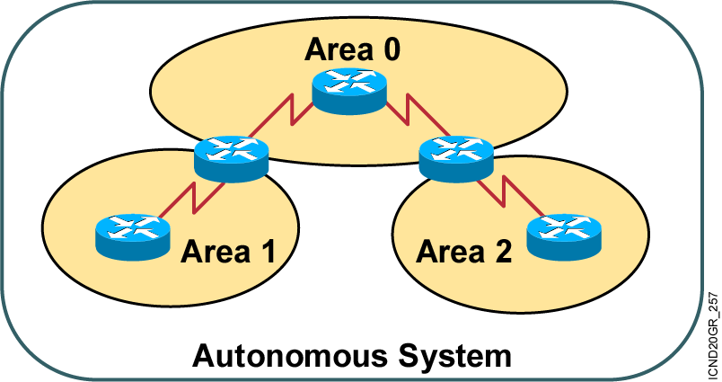
OSPF Hierarchical Routing
  Consists of areas and autonomous systems
  Minimizes routing update traffic

Slide 7
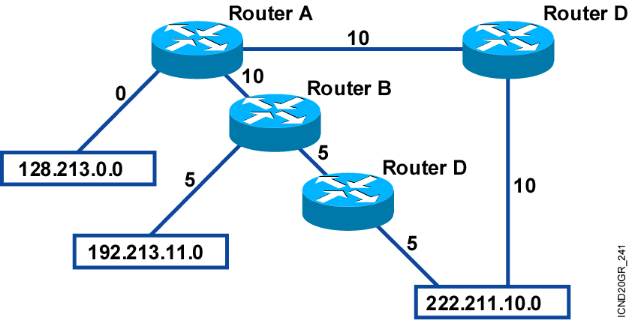
Shortest Path First Algorithm
  Places each router at the root of a tree and calculates the shortest path to each destination based on the cumulative cost
  Cost = 10⁸/bandwidth (bps)
Notes:
Purpose: The figure presents how IGRP load sharing improves throughput and increases reliability.
Emphasize: Only feasible paths can be used for IGRP load sharing.
Load-balancing methods vary according to the switching mode because the data structures for process switching, fast switching, and autonomous switching are all different. When process switching, the processor load-balances packet by packet. When fast, autonomous, or silicon switching, load balancing is done destination by destination.
By default, the amount of variance is set to one, which results in equal-cost load balancing.
You can use the default-metric command to change the default metric.
Transition: The following pages describe how to configure the IGRP routing protocol.

Slide 8
Configuring Single Area OSPF
Router(config)#router ospf process-id
Defines OSPF as the IP routing protocol
Router(config-router)#network address mask area area-id
Assigns networks to a specific OSPF area
Notes:
Slide 1 of 2
Purpose: This figure explains how to use the router igrp and network commands to configure an IGRP process.
Emphasize: Note that the AS keyword is required for IGRP.
You can use multiple network commands to specify all networks that are to participate in the IGRP process. Only those networks specified will be published to other routers.

Slide 9
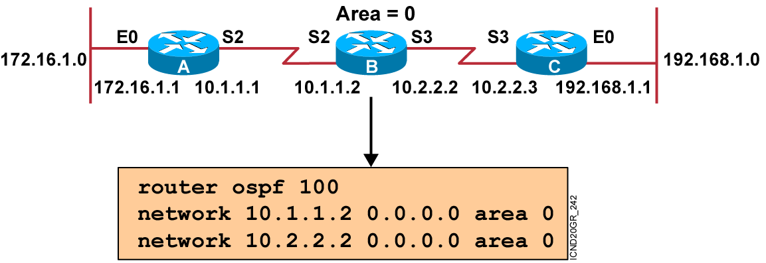
OSPF Configuration Example
Notes:
Purpose: The figure shows how the IGRP commands operate on the example network.
Emphasize: An administrator only specifies directly connected networks that should be published to other routers.
Without the network command, nothing is advertised. With a network command, the router will advertise every subnet within the Class A, B, or C network specified in the configuration.

Slide 10
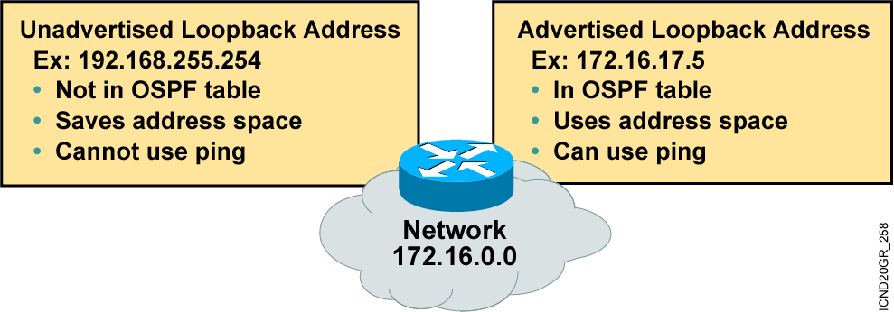
Configuring Loopback Interfaces
Router ID:
  Number by which the router is known to OSPF
  Default: The highest IP address on an active interface at the moment of OSPF process startup
  Can be overridden by a loopback interface: Highest IP address of any active loopback interface

Slide 11
Verifying the OSPF Configuration
Router#show ip protocols
Verifies that OSPF is configured
Router#show ip route
Displays all the routes learned by the router
Router#show ip ospf interface
Displays area-ID and adjacency information
Router#show ip ospf neighbor
Displays OSPF-neighbor information on a per-interface basis

Slide 12
OSPF debug commands
Router#debug ip ospf events
OSPF:hello with invalid timers on interface Ethernet0
hello interval received 10 configured 10
net mask received 255.255.255.0 configured 255.255.255.0
dead interval received 40 configured 30
Router# debug ip ospf packet
OSPF: rcv. v:2 t:1 l:48 rid:200.0.0.117
aid:0.0.0.0 chk:6AB2 aut:0 auk:
Router#debug ip ospf packet
OSPF: rcv. v:2 t:1 l:48 rid:200.0.0.116
aid:0.0.0.0 chk:0 aut:2 keyid:1 seq:0x0

Slide 13
Summary
  OSPF is an interior gateway protocol similar to IGRP, but based on link states rather than distance vectors.
  OSPF advertises information about each of its links rather than sending routing table updates like a distance vector protocol.
  The SPF algorithm places each router at the root of a tree and calculates the shortest path to each destination based on the cumulative cost required to reach that destination.
Notes:
Purpose: This slide discuss the initial configurations on the routers and switches.
Note: There is no setup mode on the Catalyst 1900 switch.

Slide 14
Summary (Cont.)
  Use the router ospf command to start an OSPF routing process and the network command to associate addresses to an OSPF area.
  You can use any one of a number of show commands to display information about an OSPF configuration.
  To display information on OSPF-related events, such as adjacencies, flooding information, designated router selection, and SPF calculation, use the debug ip ospf events privileged EXEC command.

Slide 15
